Slide 1
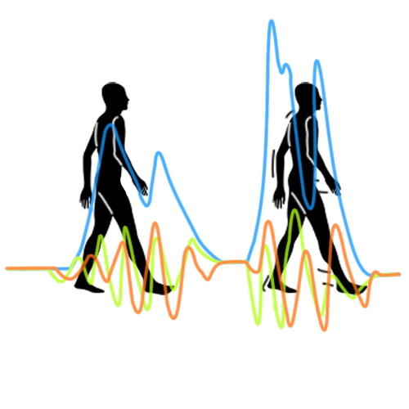


Human Motion Analysis with Xsens MTw Awinda
Submitted to Dr. Mohamed Atia to fulfill the course requirements of SYSC 5807W
Group 5
SYSC 5807-W
Dr. Mohamed Atia
Palwasha Shaikh 101198342/300124460
Hariprasad Munusamy 101132017
Shahzeb Farruk 300130852
Qingyang Li 101175476

Slide 2
Outline
Introduction
Problems with existing MoCap Systems
Alternative MoCap Systems
Project Objectives
Literature Survey
Algorithm
Experiment
Results
Challenges
Conclusion

Slide 3
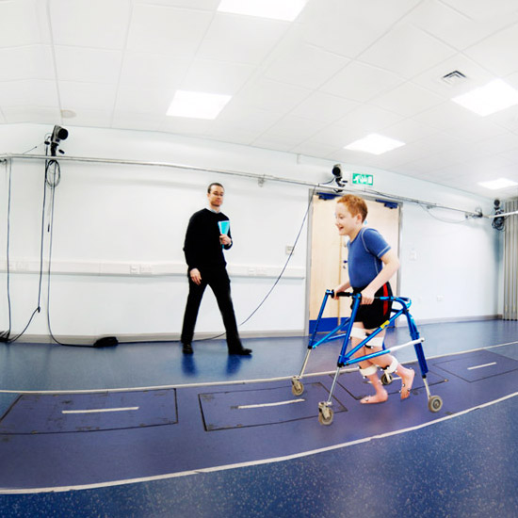
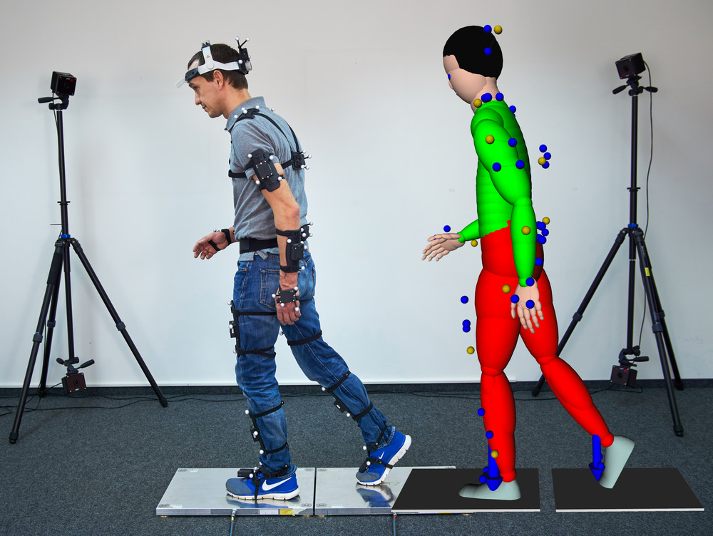
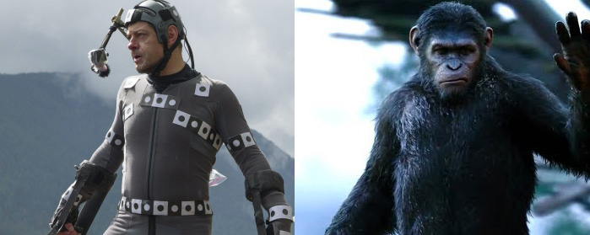
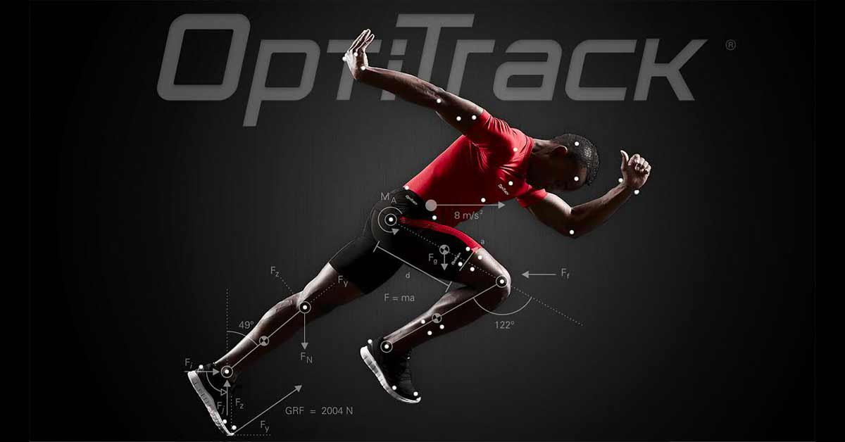
Introduction
Human motion capture and its analysis plays a vital role in many applications, such as animation, clinical, rehabilitation and healthcare analysis, human-computer interactions like virtual and augmented realities, sport training, gaming and many more.
Many motion capture (MoCap) tools and methods exist for collecting data and analyzing human motion.
One of the most widely used method is vision-based motion tracking.
MoCap Applications
Notes:
Image sources :
[1] https://www.qualisys.com/applications/
[2] https://ar-tracking.com/applications/motion-capture/
[3] https://www.slashfilm.com/the-10-best-motion-capture-characters/2/
[4] https://simplifaster.com/articles/3d-motion-capture-sport/

Slide 4
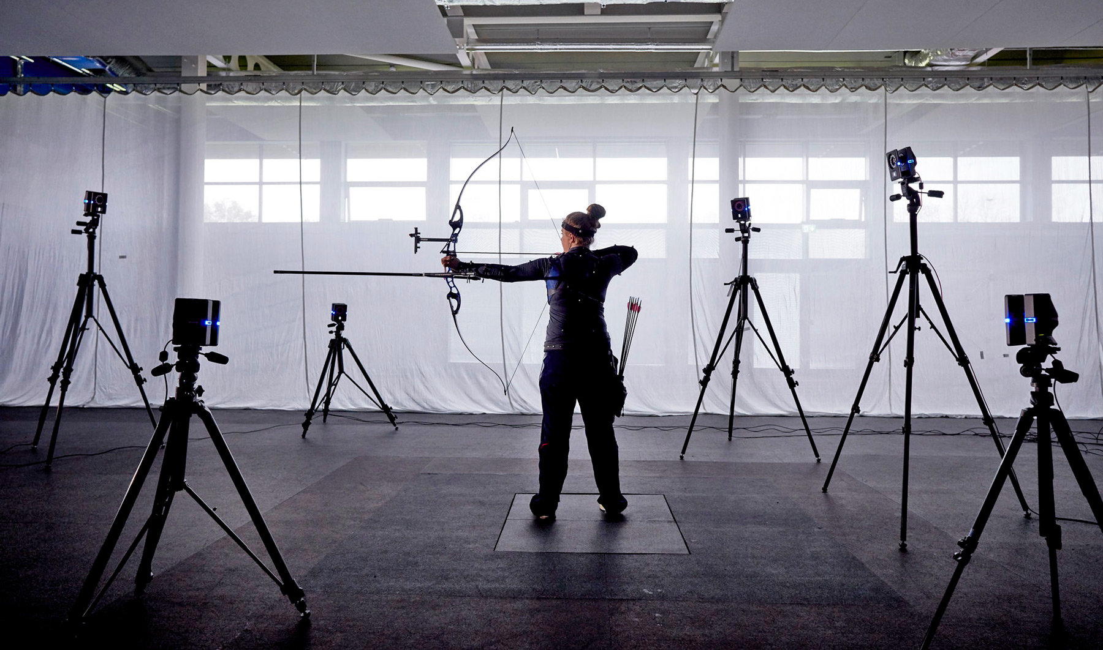
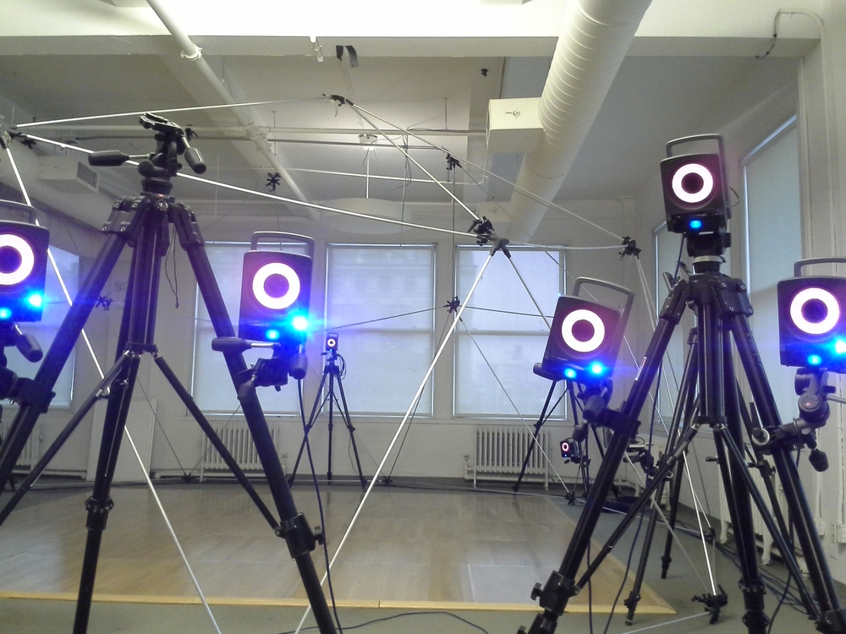
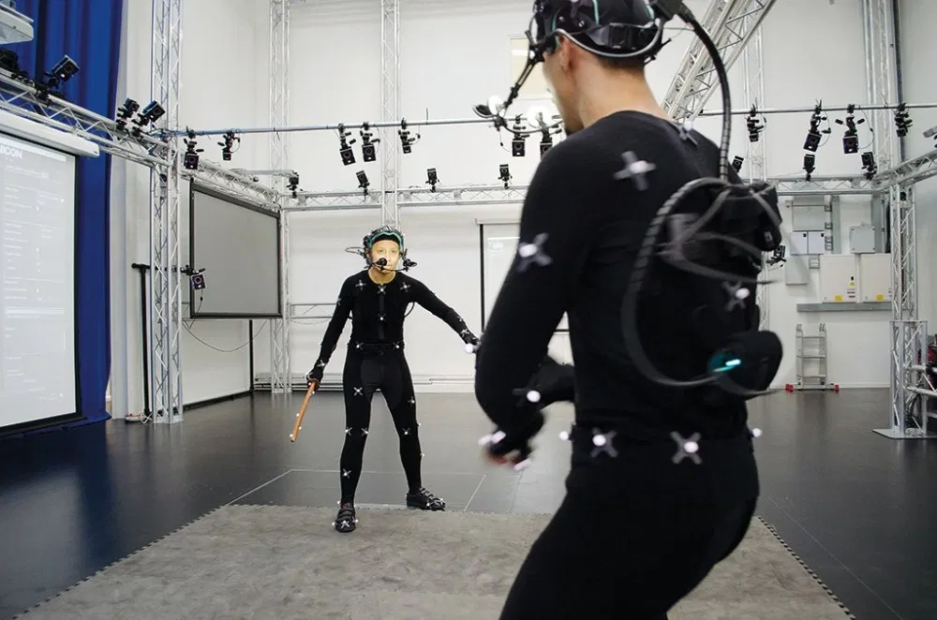
Problems with Existing MoCap System
Vision-based systems have many limitations.
Lab-like environment with a wide open-area is required for recording measurements.
Heavy and expensive equipment and their placement, specially the cameras, need to be well-planned due to their sensitivity to environmental conditions like lighting.
Markers are susceptible to occlusion due to high-mobility.
These drawbacks limit vision-based systems’ applications to high-budget animation movies, gaming and clinical analysis.
Less ideal for human motion analysis.
Vision Based MoCap Subjects and Environment
Notes:
[1]https://www.google.com/imgres?imgurl=https%3A%2F%2Fwww.xsens.com%2Fhubfs%2Fdims.jfif&imgrefurl=https%3A%2F%2Fwww.xsens.com%2Fa-history-of-motion-capture&tbnid=nqrb0lM3f5ho1M&vet=12ahUKEwiwoKbcu9joAhXFVKwKHZwbCHkQMygFegUIARDzAQ..i&docid=JsMIQyyX0cDS1M&w=1800&h=1062&q=camera%20motion%20capture%20environment%20with%20markers&ved=2ahUKEwiwoKbcu9joAhXFVKwKHZwbCHkQMygFegUIARDzAQ
[2] https://www.google.com/imgres?imgurl=https%3A%2F%2Fimages.squarespace-cdn.com%2Fcontent%2Fv1%2F537911cee4b05f3bc9357669%2F1400474016617-XTAMHWZ3JEFBP9V6V7C8%2Fke17ZwdGBToddI8pDm48kDHPSfPanjkWqhH6pl6g5ph7gQa3H78H3Y0txjaiv_0fDoOvxcdMmMKkDsyUqMSsMWxHk725yiiHCCLfrh8O1z4YTzHvnKhyp6Da-NYroOW3ZGjoBKy3azqku80C789l0mwONMR1ELp49Lyc52iWr5dNb1QJw9casjKdtTg1_-y4jz4ptJBmI9gQmbjSQnNGng%2F3Dmotioncapture.jpg&imgrefurl=http%3A%2F%2Fwww.pzaragoza.net%2F3d-motion-capture&tbnid=s36nyhpAS9ZEIM&vet=12ahUKEwiwoKbcu9joAhXFVKwKHZwbCHkQMygKegUIARD9AQ..i&docid=tTtIPLzJwZ6BUM&w=1000&h=750&q=camera%20motion%20capture%20environment%20with%20markers&ved=2ahUKEwiwoKbcu9joAhXFVKwKHZwbCHkQMygKegUIARD9AQ
[3] https://www.google.com/search?q=camera+motion+capture+suit&tbm=isch&ved=2ahUKEwjVzv_du9joAhVJSKwKHW68BdcQ2-cCegQIABAA&oq=camera+motion+capture+suit&gs_lcp=CgNpbWcQAzoECCMQJzoECAAQHjoGCAAQCBAeOgQIABAYUL3YAVjJ4QFgw-MBaABwAHgAgAFhiAHIA5IBATWYAQCgAQGqAQtnd3Mtd2l6LWltZw&sclient=img&ei=s5KNXpWpMMmQsQXu-Ja4DQ&bih=556&biw=1084#imgrc=t2eUtNJjbBGcoM

Slide 5
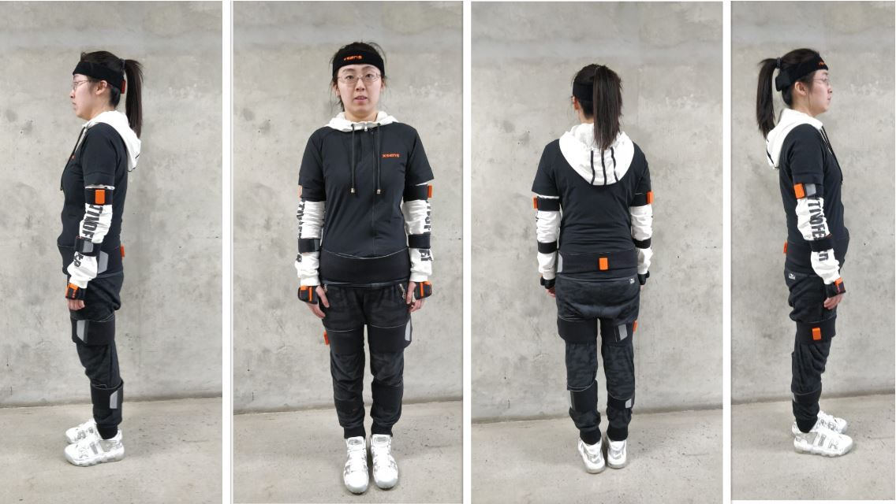
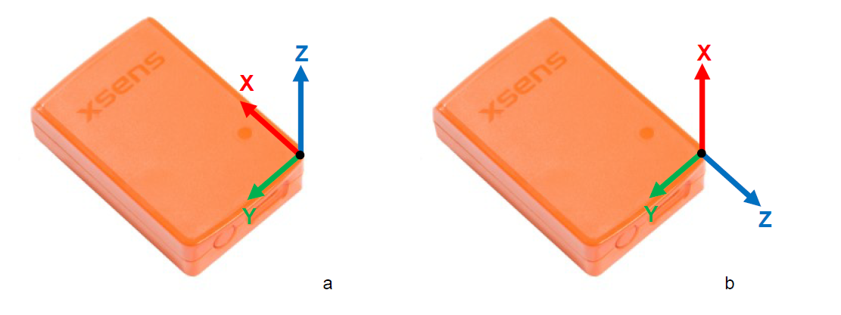
Alternative MoCap Systems
A boom in low-cost, light and small sized body wearable sensors have made body sensor networks (BSNs) very popular.
A viable solution to the constraints of vision-based MoCap techniques:
Easily operate in obtrusive and small environments.
Not dependent on an external motion capture device for recording the measurements.
Self-contained, and small and energy efficient sensors attached to the body are used.
Works extremely well for both continuous indoor and outdoor ambulatory motion measurements.
Sensors
Micro-electromechanical system (MEMS) motion sensors – MEMS based MoCap
Example: Inertial-Magnetic Measurement Unit (IMMU).
IMMUs can be purchased as single trackers or as part of BSNs, such as Xsens MVN, for full human MoCap.
Wireless IMMU based BSNs are a very good choice for MoCap, and Xsens’ MTw Awinda is chosen for conducting human motion analysis.
Xsens MTw Awinda IMMU BSN
Xsens MTw Awinda wireless IMMU sensors

Slide 6
Project Objectives
The proposed system aims at imitating what the commercial Xsens MTw Awinda system allows its users to do using its proprietary software.
Conduct an analysis of the human motion using the Xsens MTw Awinda system:
To record the raw orientation in Euler representation (roll, pitch yaw) of all 16 sensors attached to different parts of the human body (head, shoulders, chest, arms, legs, foot, etc), while performing some simple hand and foot motions.
The orientation output of the IMMUs are to be manipulated
Extract raw yet precise and low-error 16 sensors’ Euler angle data
Perform sensor to segment calibration by using transformations using forward and inverse kinematics
To visualize and analyze the human motion in 3D using a software tool like Unity3D.
A 3D skeletal model of the human body is chosen where all angles between different parts of the skeleton are known through the sensor collected data, and are mapped for visualization.

Slide 7
Literature Survey
Calibration and Segmentation Procedures
Ref. | Calibration Process | No. of Sensors | Segmentation Procedure | Cost | Accuracy | Complexity
[19] | 3 posture positions | 17 | Iterative-hand-eye collaboration procedure | Low | High | High
[20] | 1 posture with a compass or smartphone | 4 | Combining the vectors of each body segment during MoCap | Med. | Low | High
[21] | - | 17 | Template based method | Low | High | Med.
Ours with [7] | 1 posture and is automatically done with [7] using Awinda Protocol | 16 | Transformation matrices with forward and inverse kinematics | Low | Med. | Low
Table 1: Comparison of Calibration Processes and Segmentation Procedures.
Notes:
The recorded human motion can be replayed or recreated. The issue is that each sensor’s coordinate frame is not aligned with the body coordinate frame. A transformation is required for the body segment measurements. In other words, the sensor coordinate frame needs to be aligned with the body coordinate frame, and a transformation matrix needs to be computed and applied. Between the IMMU sensors and the body parts, the body segment need to be calibrated aligned for meaningful and accurate results.
Xsens MTw Awinda BSN [7] used for this project frees us from the otherwise hectic task of calibration by employing Xsens proprietary algorithms and Awinda protocol. The users must use MT Manager or MVN Analyze tool and press “Configure” to calibrate all 16 sensors simultaneously while the subject wearing the sensors stands still with arms down to the side. The sensor to segmentation process for all 16 joints is done by calculation rotation matrices for transformation, and forward and inverse kinematics is also used. The sensor to segment procedure was crucial to implement and conduct the visual analysis of the collected data. The accuracy of the simplistic solution is not very high, but the inputs are precise as Awinda protocol of the Xsens MTw [7] refines the data. It is subject to singularity and gimbal lock issues. However, the proposed software solution is very cost-effective. The latter issues of the proposed system are discussed in detail later. Table 1 compares our solution to other existing solutions in terms of calibration and sensor to link segmentation process.

Slide 8
Literature Survey (Cont’d)
Data Errors and Sensor Fusion
Ref. | Raw Data Type | Data Refinement | Sensor Fusion | Efficiency | Complexity | Data Accuracy
[22] | Quaternion | BRA | - | High | Med. | High
[23] | Quaternion | CO with LMA | - | High | High | High
[5] | Quaternion | Using UWB measurements | KF fusion algorithm | Med. | Med. | High
[24] | Quaternion | Using NIR optical sensor measurements | Motion fusion algorithm | Med. | Med. | High
[25] | Quaternion | With TOA | CRLB | Med. | Med. | High
Ours with [7] | Both quaternion and Euler angles | MTw Awinda protocol | XKF-hm | High | Low | High
Table 2: Comparison of Data Refinement and Sensor Fusion Procedures to get Visualization Data.
Notes:
The Xsens MTw Awinda MoCap system [7] used in this project can process and refine the data using its proprietary MVN Analyze tool that employs the Awinda Protocol [8], [16]. The Awinda protocol is a patented wireless communication protocol constructed by a Strap Down Integration (SDI) algorithm to compute accurate angle measurements [16]. Further, the 16 sensors’ data are filtered for errors and is fused together using Xsens’s patented XKF-hm [16]. From an analyst’s point of view, compared to other non-commercial systems built from low-cost IMMU sensors, the Xsens MTw Awinda MoCap provides a highly accurate data that is filtered for noise and errors. The data from this commercial system can be taken right away to perform visual motion analysis. Thus, saving time of the analyst by being very efficient and low in complexity. Table 2 shows the system used for analysis compared to existing systems.
Abbreviations:
bidirectional recurrent autoencoder (BRA)
CO w/ LMA =Comp. Observer with the Levenberg Marquardt algorithm
Ultra-Wide Band (UWB) localization system
time-of-arrival (TOA)
Cramér–Rao lower bound (CRLB)
Near-Infrared (NIR) optical sensor

Slide 9

Algorithm
ENU Coordinates
Forward-Kinematics
Inverse-Kinematics
Hierarchy design and Joint links
Architecture of proposed model
Rotation mapping based on hierarchy

Slide 10
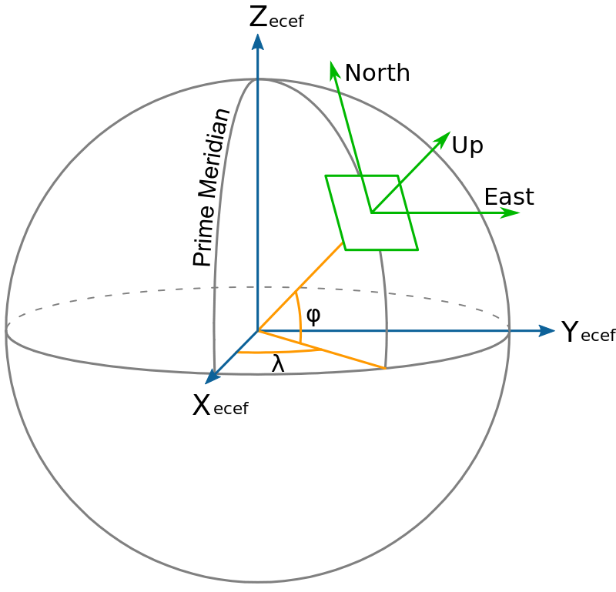
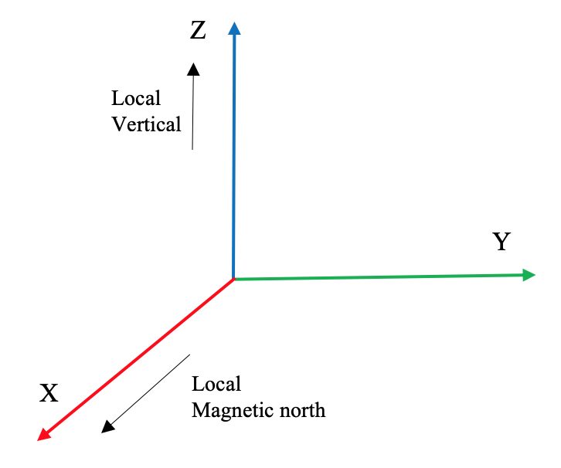
East North Up(ENU) Coordinates
ENU coordinate system with respect to ECEF
ENU Frame

Slide 11


Forward-Kinematics
Rotation matrix using Euler angles :
Rotation matrix using quaternion values:

Slide 12

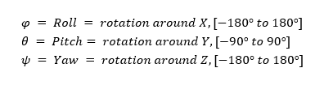
Inverse-Kinematics
Neglecting the singularity condition from DCM matrices:

Slide 13
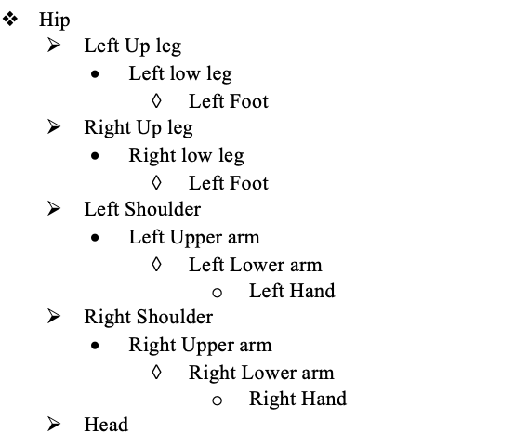
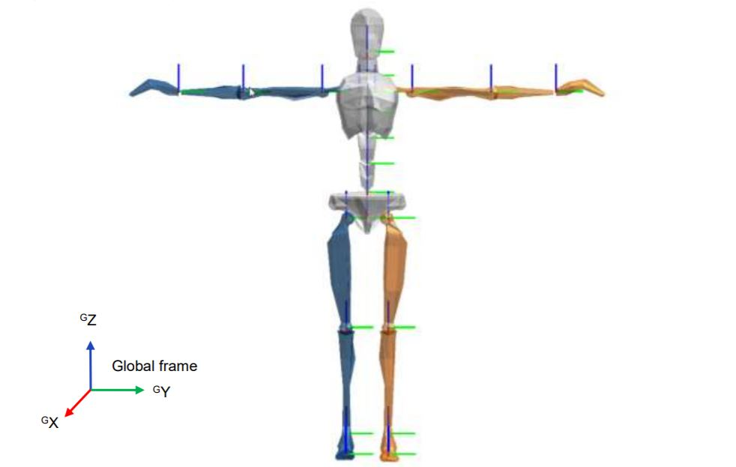
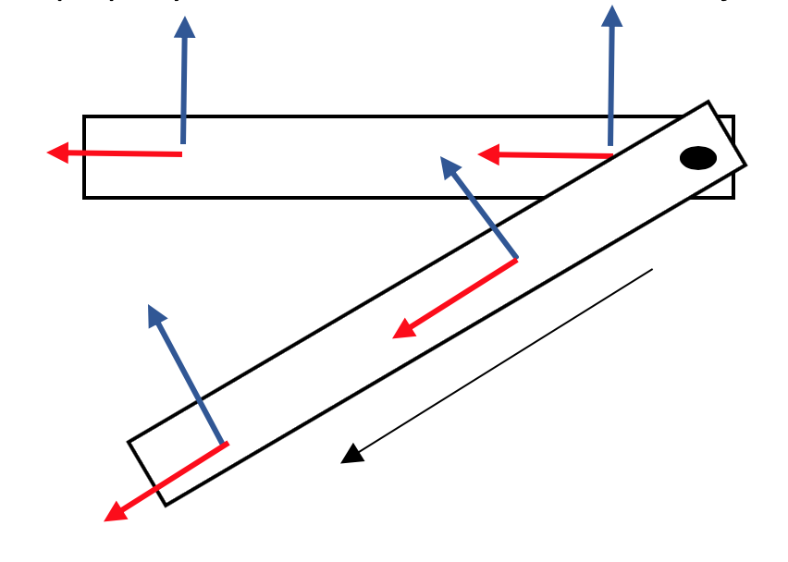
Hierarchy Design and Joint Links
Frame movement across the joint link
Sensor placement and initial frames
Skeleton Hierarchy

Slide 14
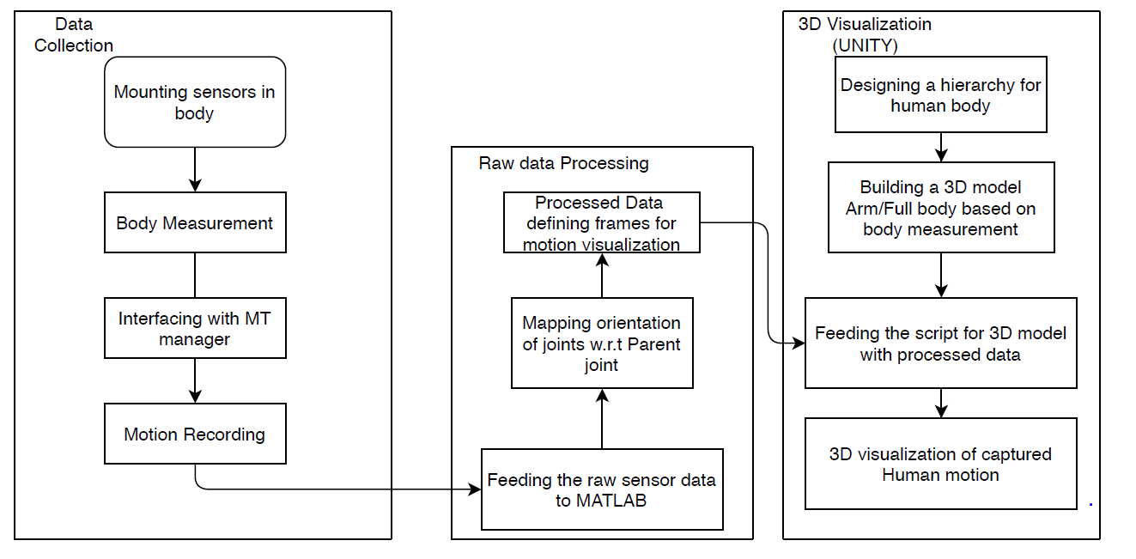
Architecture of the proposed model
The block diagram of the proposed 3D Human motion analysis system.

Slide 15

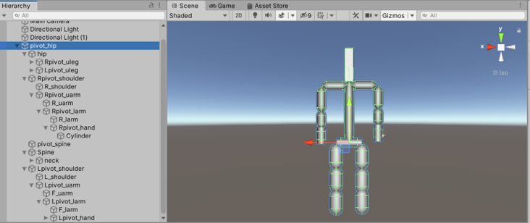


Mapping the rotation of Joints w.r.t Parent
Skeleton built using the hierarchy in Unity 3D

Slide 16
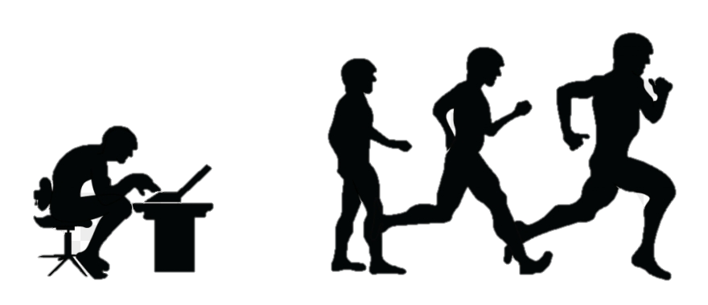
Experiment
DEMO

Slide 17
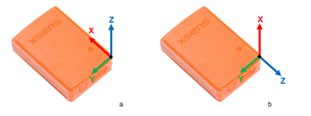
Data Collection
The wireless MTW Awinda sensors have their own reference frame ENU.The number of packets depends on the sampling frequency, these packets must be sampled as frames accordingly to be in synchronization with motion video captured.

Slide 18
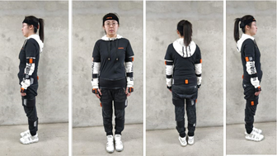
Initial Body Position
Four datasets were recorded for analysis making sure all the sensors are displaced from its initial orientation and position.
Initial testing analysis was done using Single Sensor. Then complete right arm. The skeleton is built with the body measurement made and fed with sensor values after processing mapping every joint w.r.t parent joint
Figure:The sensor placement according to the hierarchy

Slide 19
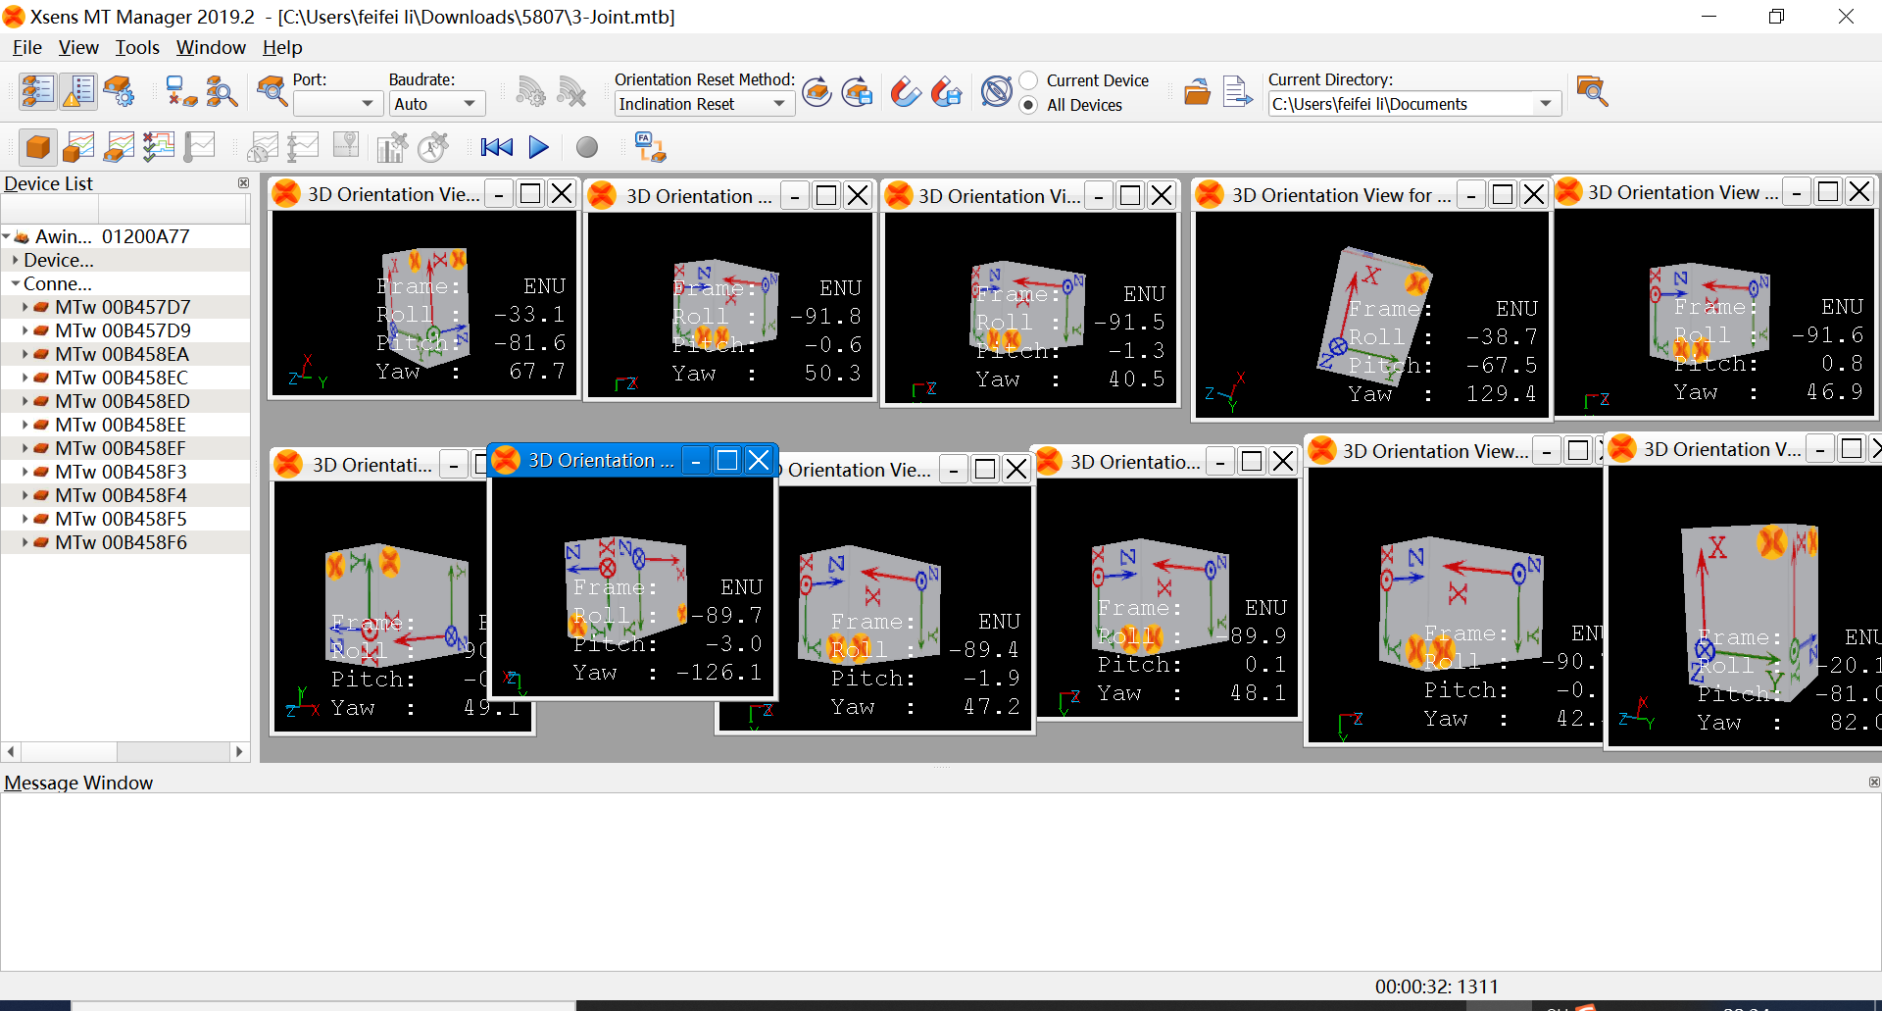
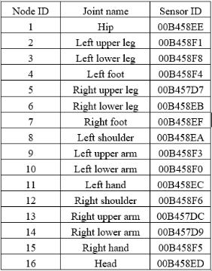
Interfacing with MT manager
Each sensor is identified by its unique ID and attached to its respective position as shown in table 4
The rotation of sensors attached to the body surface of the user, in MT manager

Slide 20
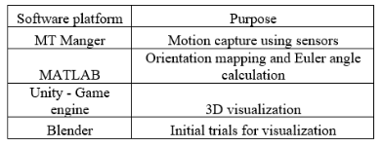
Softwares Used:

Slide 21
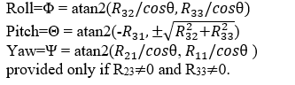
Experiment:1 Demonstration of Forward Kinematics and Inverse Kinematics (using Euler angles)

Slide 22
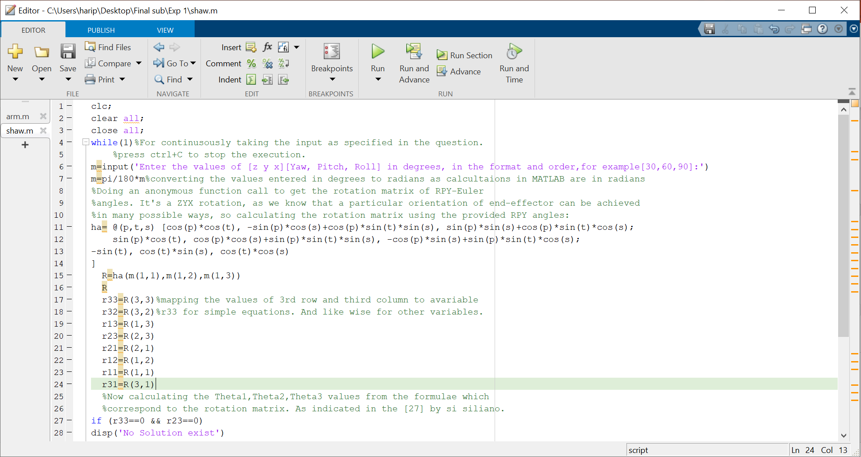
Experiment:1_a Explains the two possible solution of Euler angles using MATLAB
We know that a orientation of end-effector can be achieved
in many possible ways, so calculating the rotation matrix
using the provided RPY angles:
The calculation of pitch results in two possible solution,
Resulting in two set of Euler angles

Slide 23



Singularities

Slide 24
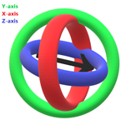
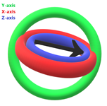
Gimbal Lock Problem
In this problem, strange rotations can occur between keyframes unexpectedly.
Each ring in the diagrams shown is called as a gimbal.
A gimbal can be defined as a pivoted support that allows the rotation of an object about a single axis.
To avoid gimbal lock the rotation order of an object may changed, but still gimbal lock problem will persist in any order of rotation one after another.
a
b
Gimbal Lock Problem

Slide 25
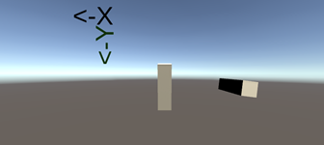
Experiment:1_b. Visualization of Gimbal Lock Problem in Unity3D
The two rectangles represented in the above fig, the one on left does rotation with Euler angles (transform. Euler Angles) while the that on the left does rotation using quaternions (i.e. transform. Rotation in C# script). Both the cylinders are rotated about Y-axis by 90˚ and continuously about Z by 90˚ per second.
https://youtu.be/AvYjiupEAEc

Slide 26
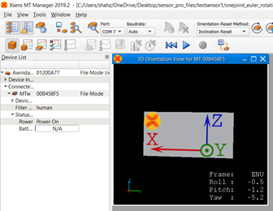
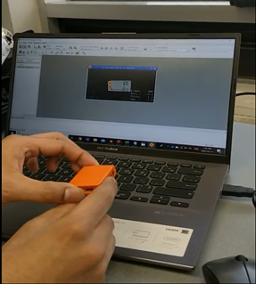
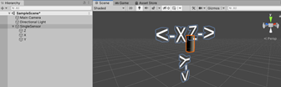
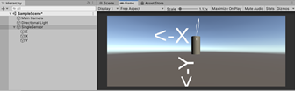
Experiment:2 Virtualization and demonstration of elementary rotation by using the data set captured for one sensor.

Slide 27
Experiment:2 Single Sensor rotation in Unity 3D
The singularities are not observed as the RPY angles are varied continuously in one of the axes in single direction and not varied simultaneously by high values in all axes together. Some variations exist in other axes but by very small amount. Also, Gimbal lock problem is not witnessed as the rotations are close to elementary rotations so the possibility of the axes getting aligned is far from happening which persist if we use Euler angles.
https://youtu.be/7psPbk4-_Xo

Slide 28


Experiment:3 Visualization of 3-joint human right-arm motion in Unity 3D
The rotation of every joint must be mapped to its parent joint, based the human skeleton hierarchy created.
The rotation matrix can be calculated based on the Euler values obtained from every sensor.
The rotation or orientation of a joint can be represented w.r.t to its parent joint as shown below:
To match the initial frames of the joint with the reference ENU frame we use intrinsic elementary rotations.

Slide 29
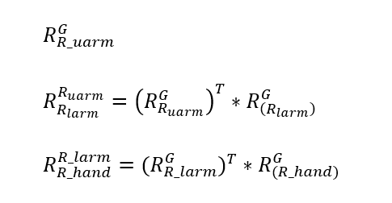
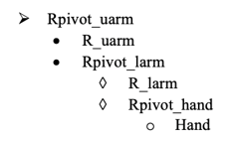
Experiment:3 Visualization of 3-joint human right-arm motion in Unity 3D
The MATLAB output defining the orientation of upper arm, lower arm and hand are given to corresponding pivot points which is the end of the link.

Slide 30
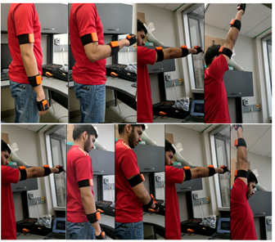
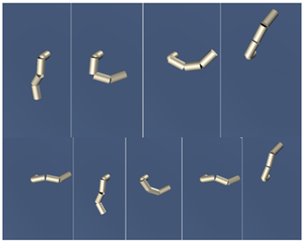
Experiment:3 Visualization of 3-joint human right-arm motion in Unity 3D
https://youtu.be/zA1tWpJPCAA

Slide 31
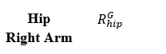
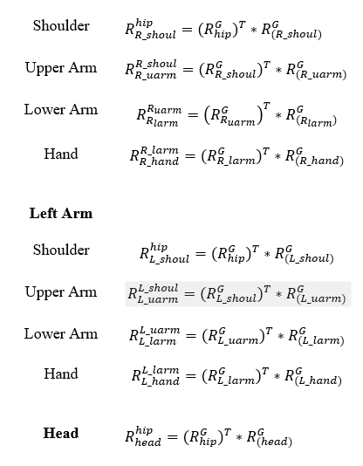
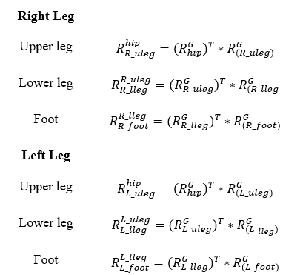
Experiment 4: Visualization of 16-senor Full human body motion in Unity3D

Slide 32

Experiment:4 Visualization of 16-senor
Full human body motion in Unity 3D. Not 16 joint watch clearly, we have 17. Every where we have to make the change.

Slide 33
Processing Raw Data in MATLAB
The raw data from the sensors must be processed before proceeding with visualization. Based on analysis of the body part either a single arm or the entire body the sensor inputs are processed using MATLAB. The MATLAB take the Euler angle roll, pitch and yaw and calculates the DCM or the rotation matrix of joints for each packet given. Then the rotation of a joint is mapped. The ENU reference frame is denoted as G.

Slide 34
Results
https://drive.google.com/drive/folders/18R9MUnMy_8ZOVPhlEFFycdllivCU04Av
YouTube Video Link:
Visualization of 3-joint human right arm motion in Unity 3D: https://youtu.be/zA1tWpJPCAA
Single Sensor Elementary rotation using Euler Rotations in Unity 3D: https://youtu.be/7psPbk4-_Xo
Gimbal Lock Problem using Unity 3D: https://youtu.be/AvYjiupEAEc

Slide 35
Conclusion
A novel low-cost and viable system for quick human motion analysis of MEMS based MoCap system’s data is proposed. The system is unique in its purpose.
The sensor data was successfully transformed from the common ENU reference frames to sensor data referencing other sensors using the carefully defined hip originating parent-child hierarchy.
MATLAB was another alternative that was explored and abandoned, as it did not meet our simplicity objective. Finally, Unity3D with its accurate physics engine proved to be the best choice.
The right-arm motion with 3 joints experimentally verified the designed system. It is proved that this low-cost and computationally simple system helps visualize captured motion with good consistency. In the future, the implementation can be easily scaled to demo all 16-joints for low-cost and simple analytical applications

Slide 36
From the resultant rotation matrix of every joint the Euler angles defining the joints rotation in x, y and z axis is calculated. Now, the resultant joint orientations are given w.r.t the parent-child relationship mapping the rotation to next immediate parent in the skeleton. The processed data for every packet is fed as frames to visualization software.

Slide 37
Appendix
We implement joint coordinate position control: directly input the given value of joint displacement.

Slide 38
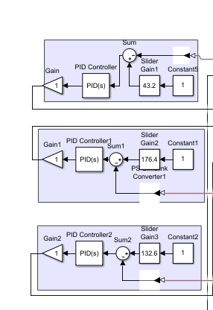
Appendix

Slide 39
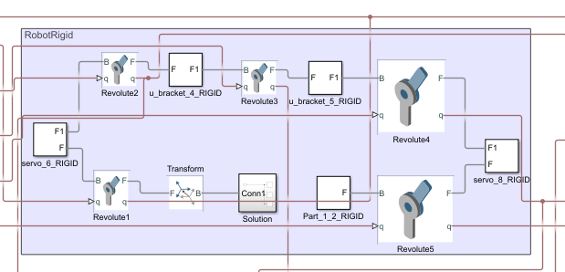
Appendix
motion activatOR

Slide 40
Appendix
Robot arm

Slide 41
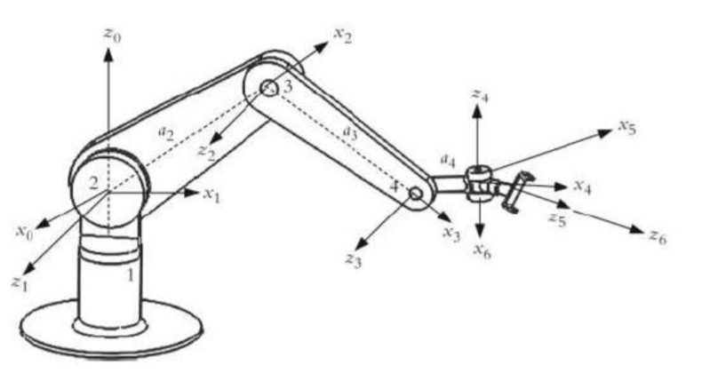
Appendix
GUI kinematics calculation section with the PID controller. RHR=A1A2A3A4A5A6

Slide 42
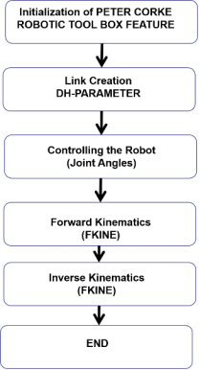
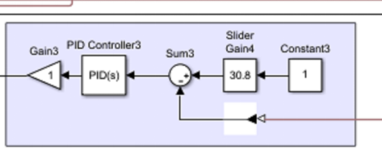
Appendix
GUI kinematic calculation section
GUI kinematic calculation section

Slide 43
REFERENCES (for Literature Survey)
[5] J. A. Corrales, F. A. Candelas, and F. Torres, “Hybrid tracking of human operators using IMU/UWB data fusion by a Kalman f ilter,” in HRI 2008 - Proceedings of the 3rd ACM/IEEE International Conference on Human-Robot Interaction: Living with Robots, 2008, pp. 193–200, doi: 10.1145/1349822.1349848.
[7] G. Bellusci, F. Dijkstra, and P. Slycke, “Xsens MTw : Miniature Wireless Inertial Motion Tracker for Highly Accurate 3D Kinematic Applications,” Xsens Technol., no. April, pp. 1–9, 2013.
[19] Y. T. Liu, Y. A. Zhang, and M. Zeng, “Sensor to segment calibration for magnetic and inertial sensor based motion capture s ystems,” Meas. J. Int. Meas. Confed., vol. 142, pp. 1–9, Aug. 2019, doi: 10.1016/j.measurement.2019.03.048.
[20] N. Choe, H. Zhao, S. Qiu, and Y. So, “A sensor-to-segment calibration method for motion capture system based on low cost MIMU,” Meas. J. Int. Meas. Confed., vol. 131, pp. 490–500, Jan. 2019, doi: 10.1016/j.measurement.2018.07.078.
[21] Q. Yuan, I. M. Chen, and A. W. Sin, “Method to calibrate the skeleton model using orientation sensors,” in Proceedings - IEEE International Conference on Robotics and Automation, 2013, pp. 5297–5302, doi: 10.1109/ICRA.2013.6631335.
[22] S. Li, Y. Zhou, H. Zhu, W. Xie, Y. Zhao, and X. Liu, “Bidirectional recurrent autoencoder for 3D skeleton motion data refinement,” Comput. Graph., vol. 81, pp. 92–103, Jun. 2019, doi: 10.1016/j.cag.2019.03.010.
[23] H. Fourati, N. Manamanni, L. Afilal, and Y. Handrich, “Complementary observer for body segments motion capturing by inertial and magnetic sensors,” IEEE/ASME Trans. Mechatronics, vol. 19, no. 1, pp. 149–157, Feb. 2014, doi: 1 0.1109/TMECH.2012.2225151.
[24] M. R. Siddiquee et al., “Sensor Fusion in Human Cyber Sensor System for Motion Artifact Removal from NIRS Signal,” in International Conference on Human System Interaction, HSI, 2019, vol. 2019-June, pp. 192–196, doi: 1 0.1109/HSI47298.2019.8942617.
[25] C. Xu, J. He, X. Zhang, X. Zhou, and S. Duan, “Towards human motion tracking: Multi-sensory IMU/TOA fusion method and fundamental limits,” Electron., vol. 8, no. 2, Feb. 2019, doi: 10.3390/electronics8020142.

